Slide 1
Predicate Resolution
Student Ciocan Florin, Group 912

Slide 2
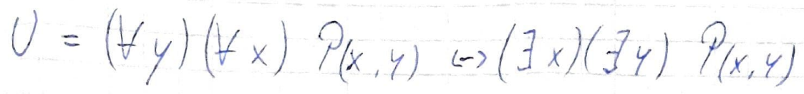
Exercise 5.2
Check if the following formula is theorem or not using predicate resolution

Slide 3
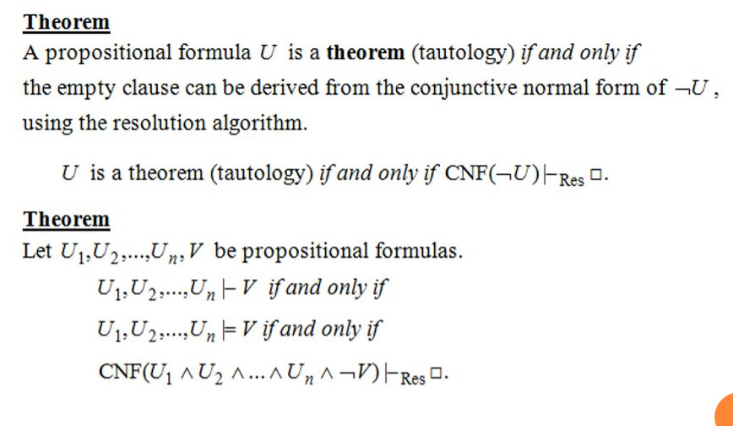
Theoretical results

Slide 4
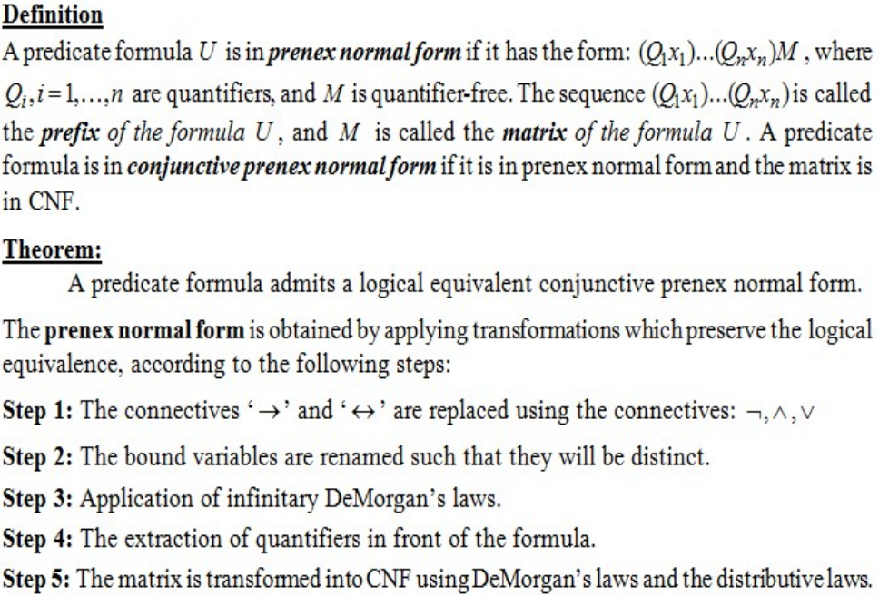
Prenex normal form

Slide 5
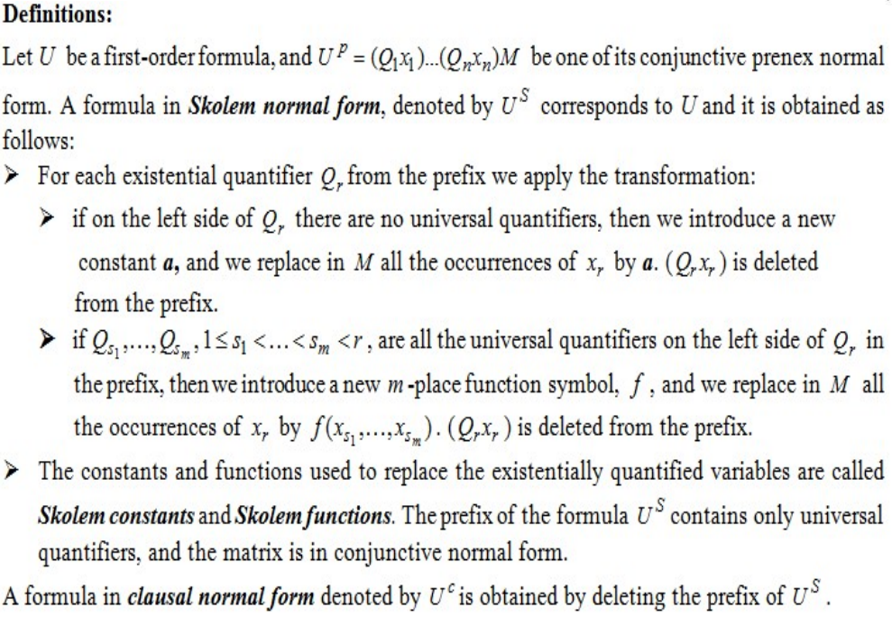
Skolem and clausal normal forms

Slide 6
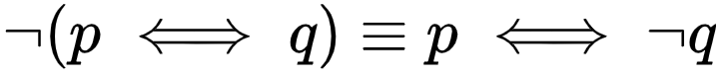
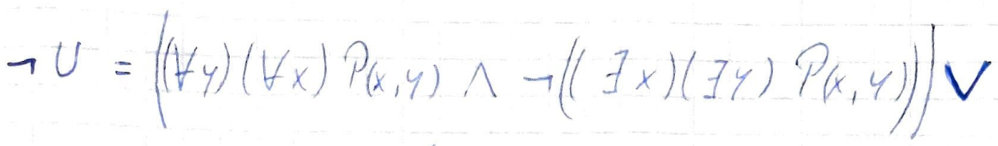
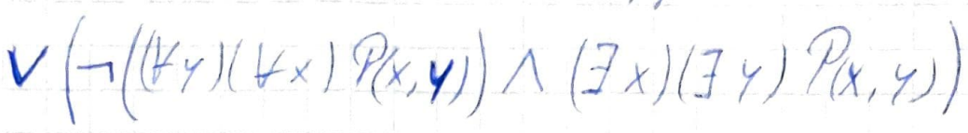
Solution + Remarks
Negate formula and replace

Slide 7
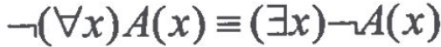
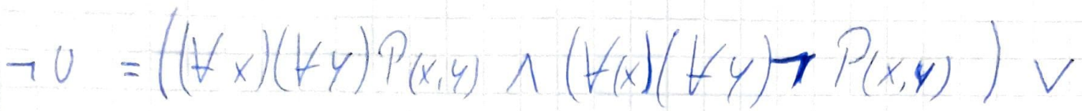
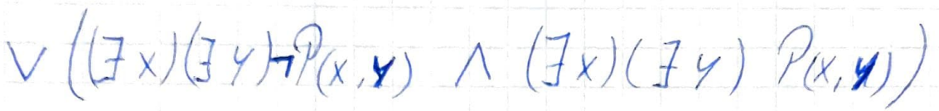
Apply DeMorgan Law

Slide 8
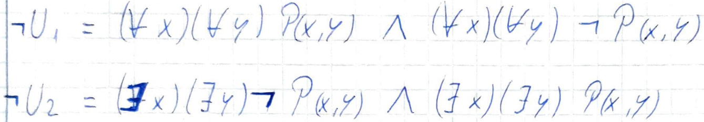
Split in two

Slide 9
Renaming the bound variables
Prenex form
- Extract quantifiers in front

Slide 10
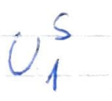
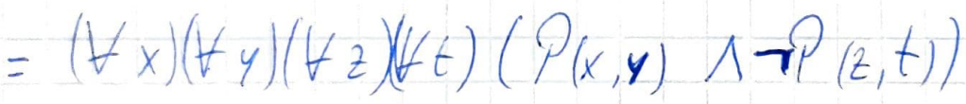
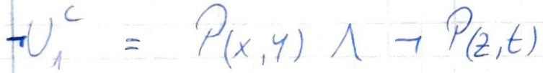
Skolem form
Clausal normal form

Slide 11
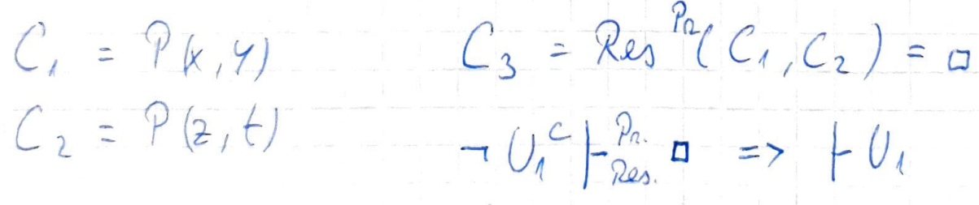
Clauses and Resolvents

Slide 12
Renaming the bound variables
Prenex form
- Extract quantifiers in front

Slide 13
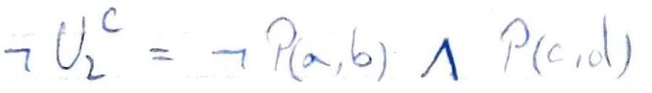
Skolem form
Skolem constants
Clausal normal form

Slide 14
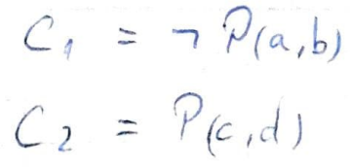
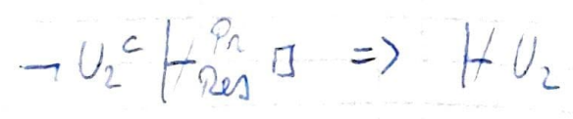
Clauses and Resolvents
¬ P(a,b) and P(c,d) are not unifiable because a,b,c,d are distinct constants, so the clauses C1, C2 do not resolve =>
=>

Slide 15
Conclusion
Initial formula U is not a theorem

